Slide 1
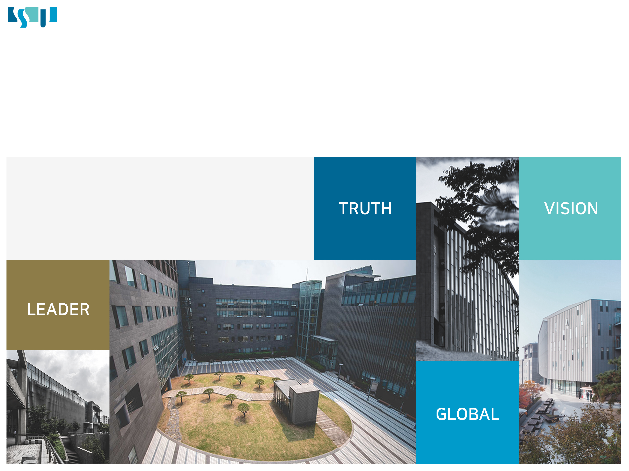
Real-time image-based obstacle detection and identification system using deep learning on railroad tracks environments
딥러닝 기반 실시간 철도 장애물 감지 및 식별 시스템
Presenter : Kim Minseok
Software Department In Soongsil Univ.

Slide 2
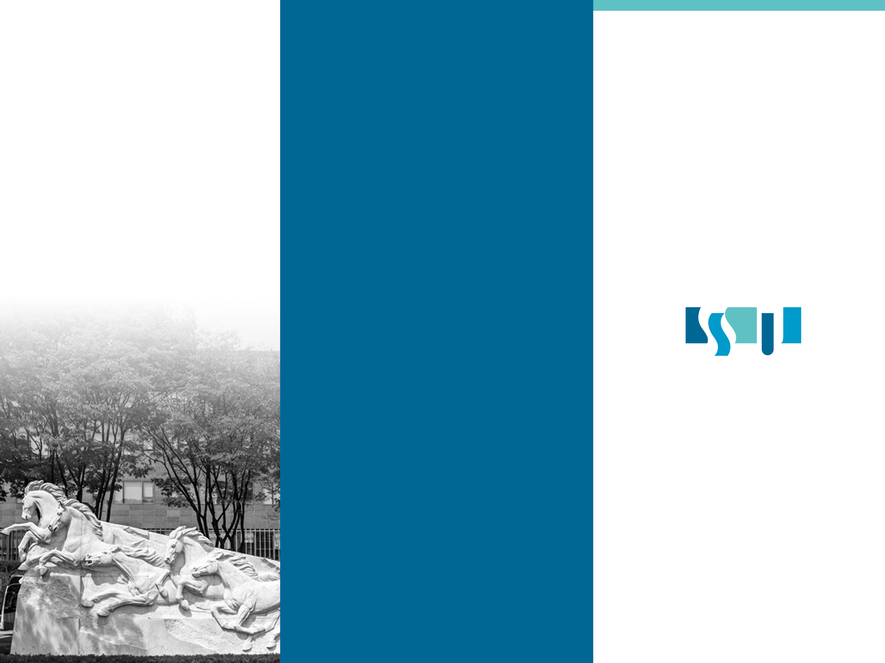
Project Team Member
1. Kim Minseok
2. Lee Juhui

Slide 3
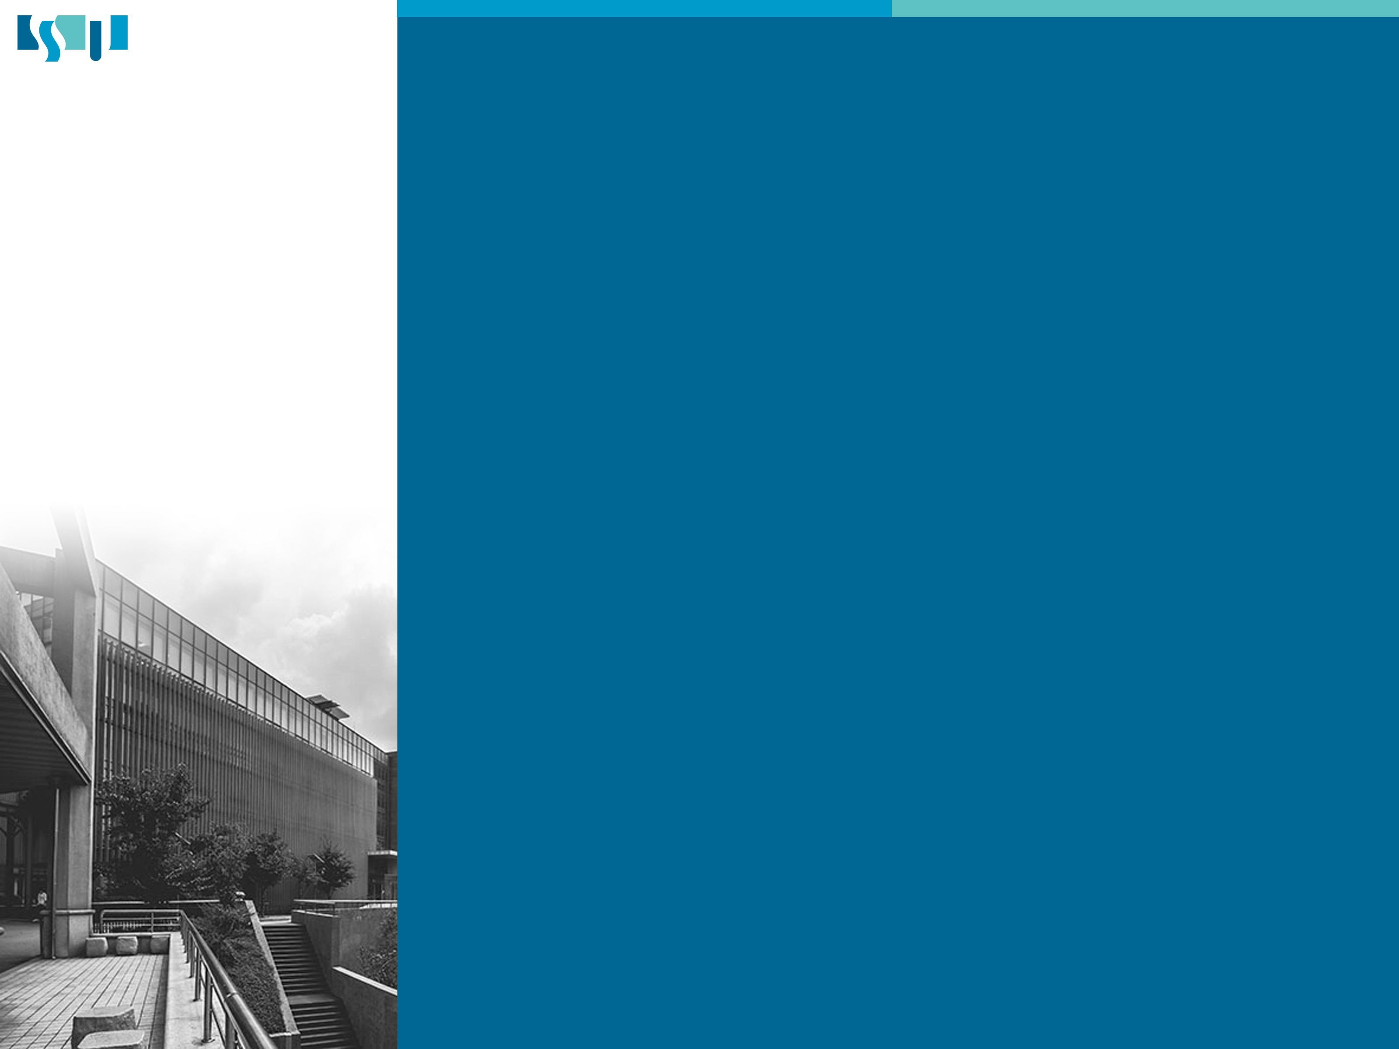
Contents
Topic
Tech
Test

Slide 4

Topic
1
Needs and Environment

Slide 5

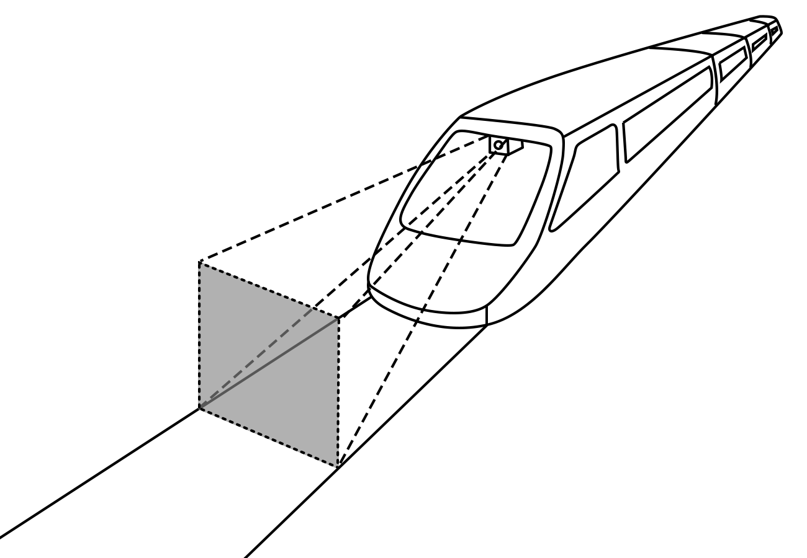
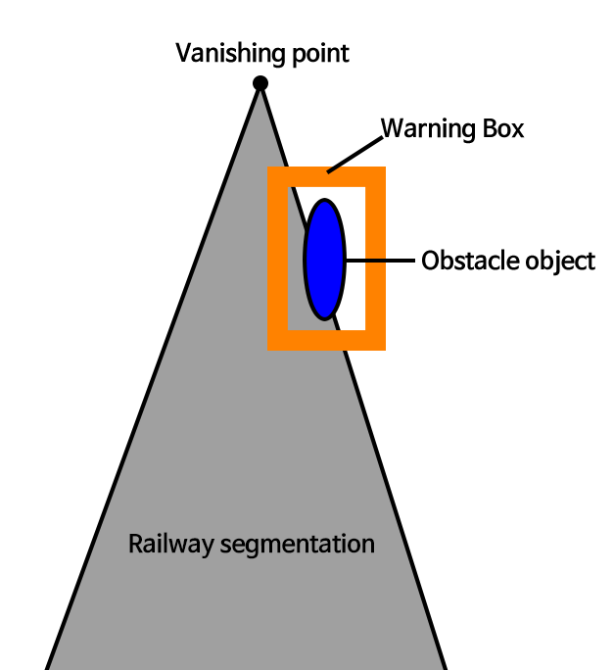
Railway Obstacle Detector
Technology For Train Autonomous Driving

Slide 6

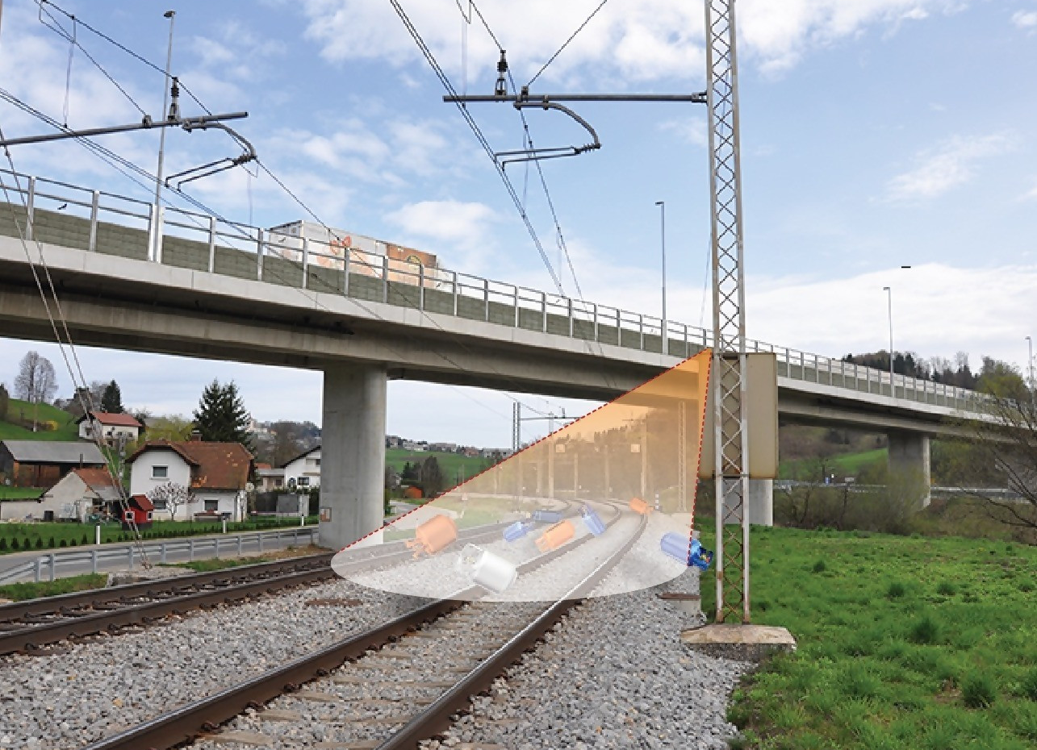
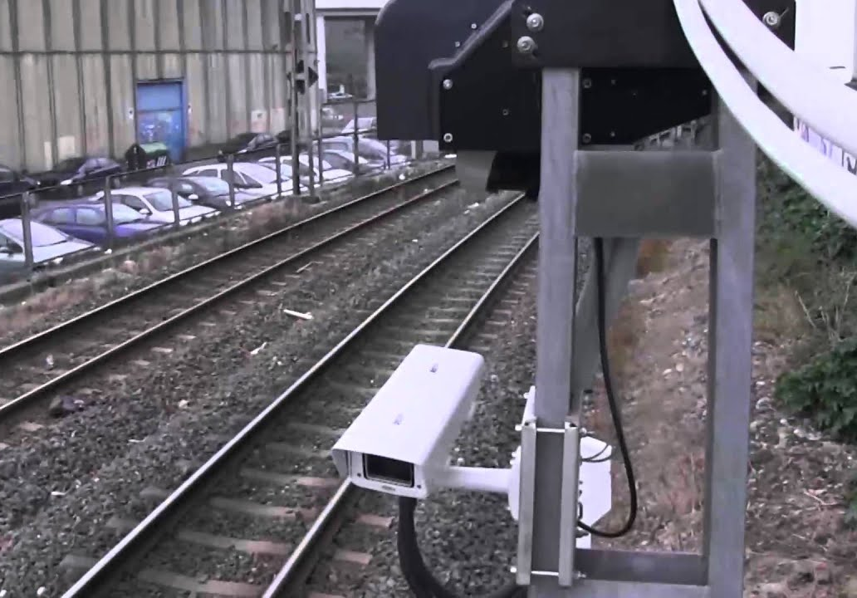
In previous research, a system fixed to the track is used
Reperences
https://www.virtualmarket.innotrans.de/en/SALVIS-X-Obstacle-Detection-System-for-monitoring-of-railway-tracks-under-the-road-overpasses,p1625580
https://www.youtube.com/watch?v=JGw6QpYShgY

Slide 7
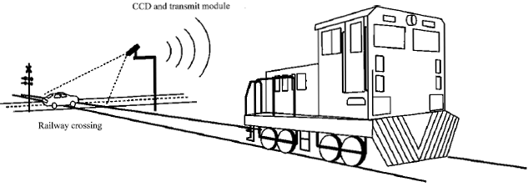
In previous research, a system fixed to the track is used
Reperences
https://www.virtualmarket.innotrans.de/en/SALVIS-X-Obstacle-Detection-System-for-monitoring-of-railway-tracks-under-the-road-overpasses,p1625580
https://www.youtube.com/watch?v=JGw6QpYShgY

Slide 8
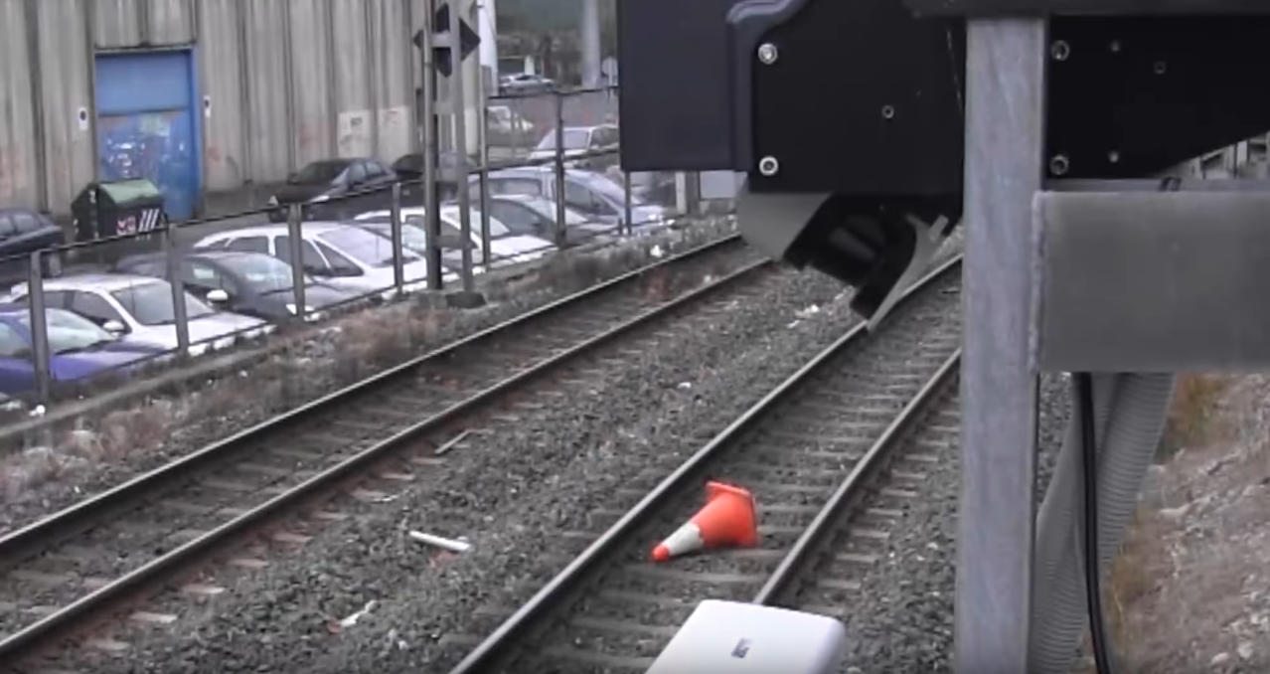
Exist study
Reperences
https://www.youtube.com/watch?v=JGw6QpYShgY

Slide 9
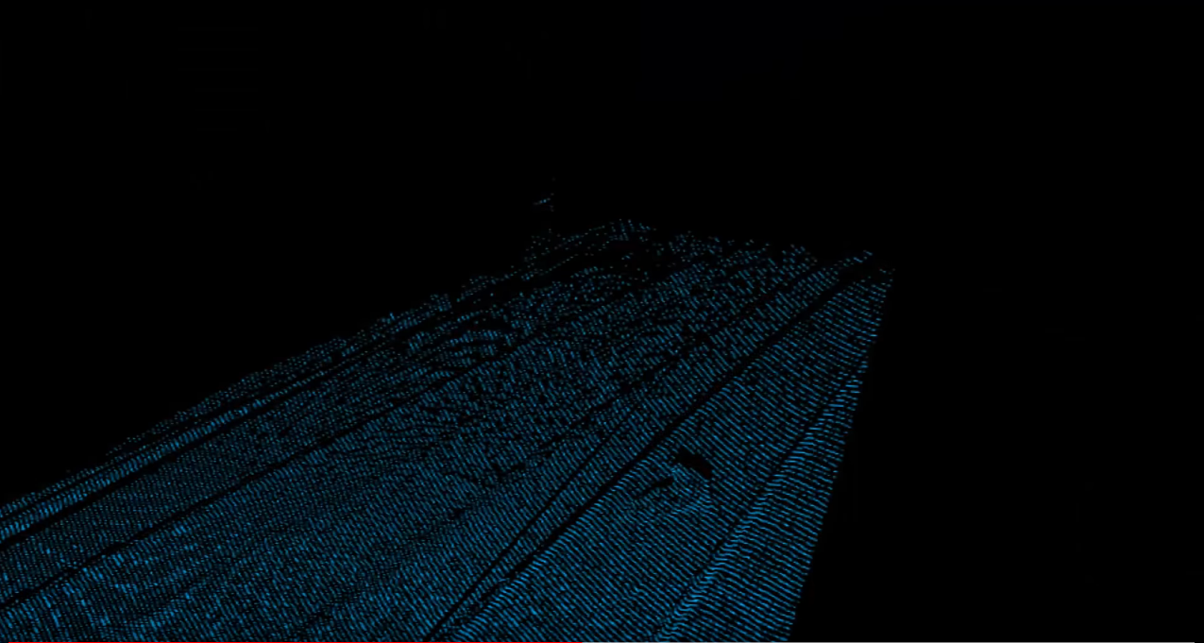
Exist study
Reperences
https://www.youtube.com/watch?v=JGw6QpYShgY

Slide 10
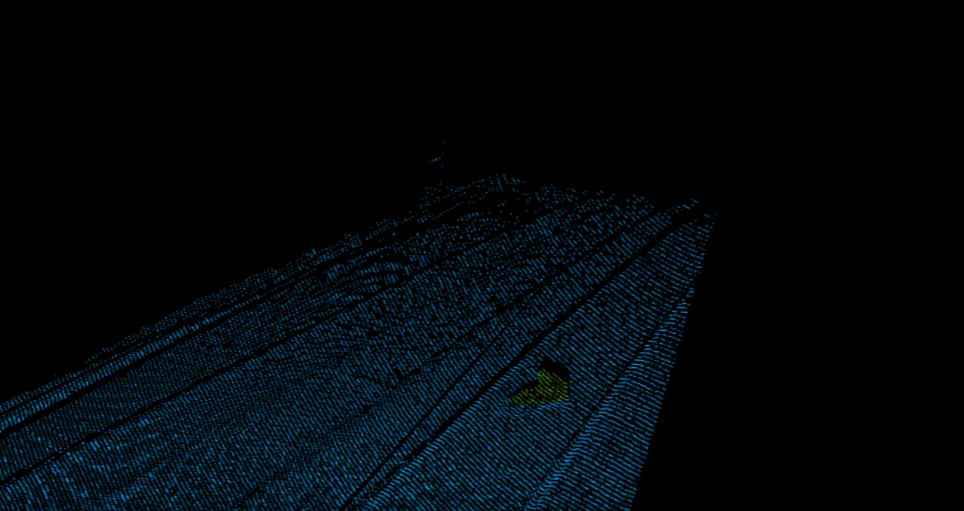
Exist study
Reperences
https://www.youtube.com/watch?v=JGw6QpYShgY

Slide 11
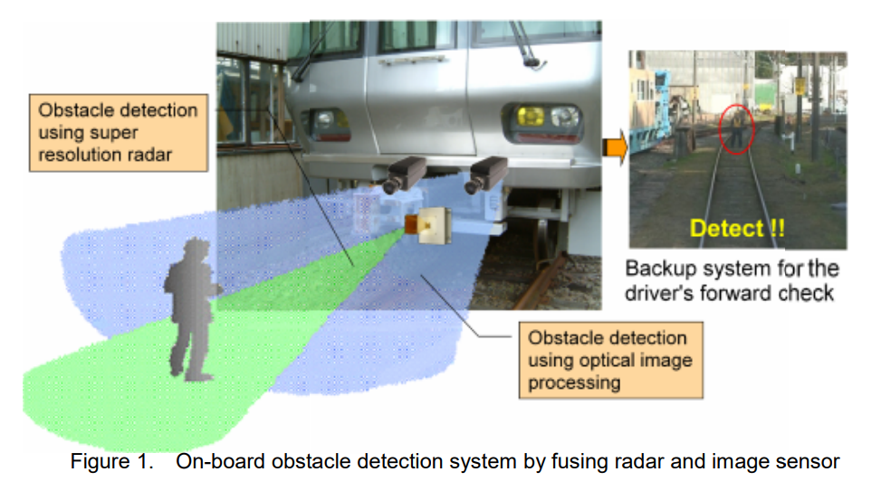
Exist study
Reperences
Masato Ukai, Bogdan Tomoyuki Nassu, Nozomi Nagamine, Masato Watanabe, Takayuki Inaba; “Obstacle Detection on Railway Track by Fusing Radar and Image Sensor”, 2011 2p table 1, figure 1 (https://www.semanticscholar.org/paper/Obstacle-Detection-on-Railway-Track-by-Fusing-Radar-Ukai-Nassu/d0ba8b60980b940446f581ba87f871a325cf3cca)

Slide 12

Tech
2
Models and visualization

Slide 13

Used model for railway tracking
Model : U-net
Benefit
Suitable for image processing
Fast speed
Don’t fall for a trade off by patch size
We need detail probability graph

Slide 14

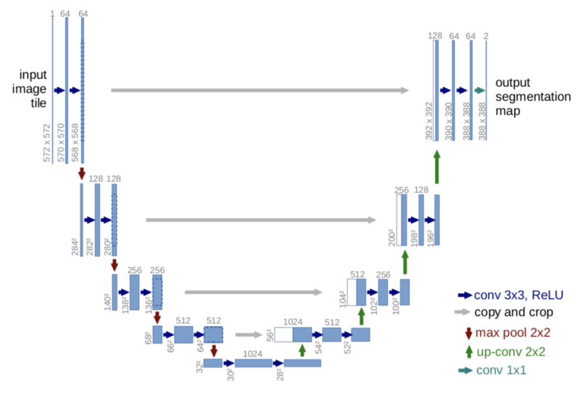
U-net
Reperences
https://github.com/zhixuhao/unet

Slide 15
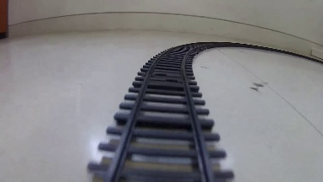

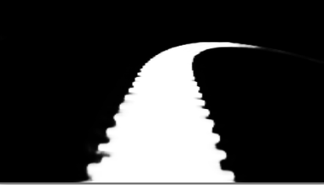
U-net
Limitness
Weak in far distance
Weak in curve railway
Original
Mask
Predicted
We used 1212 images to train model

Slide 16
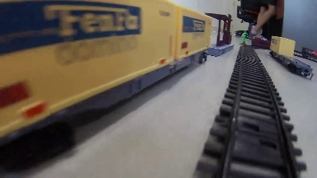
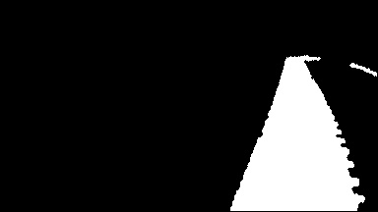
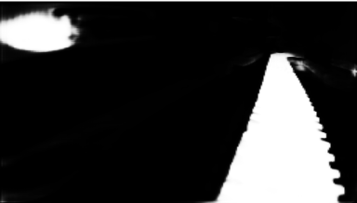
U-net
Limitness
Weak in blind object
Weak in complex env
Wrong recognization
Original
Mask
Predicted
We used 1212 images to train model

Slide 17
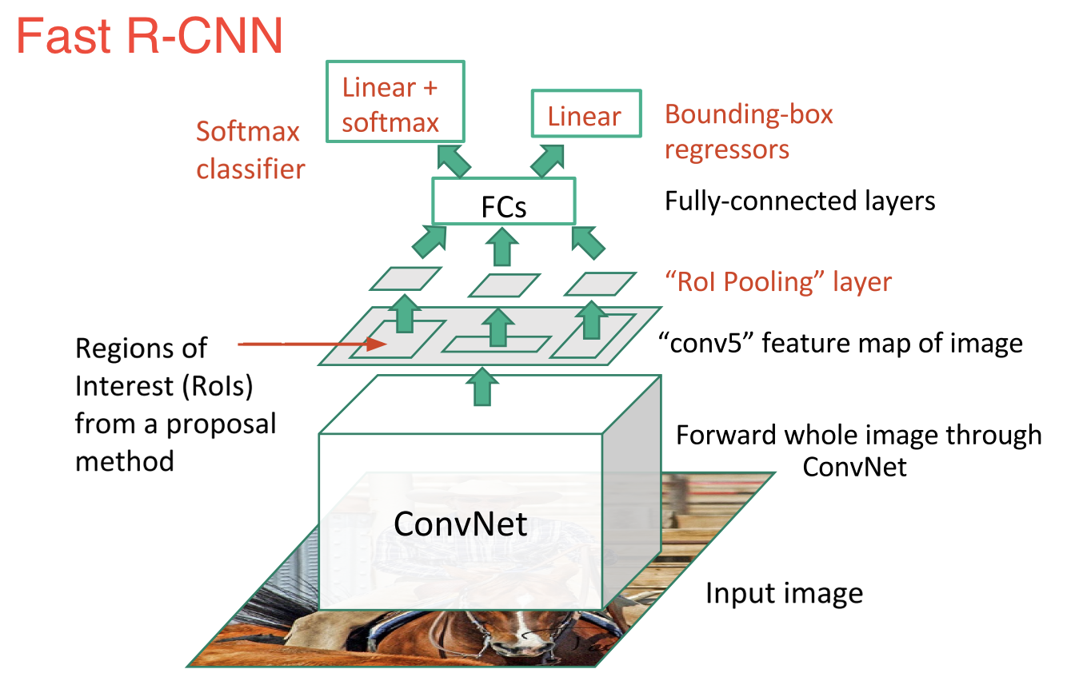
Model : faster rcnn inception v2 coco
Used model for Obstacle detection

Slide 18
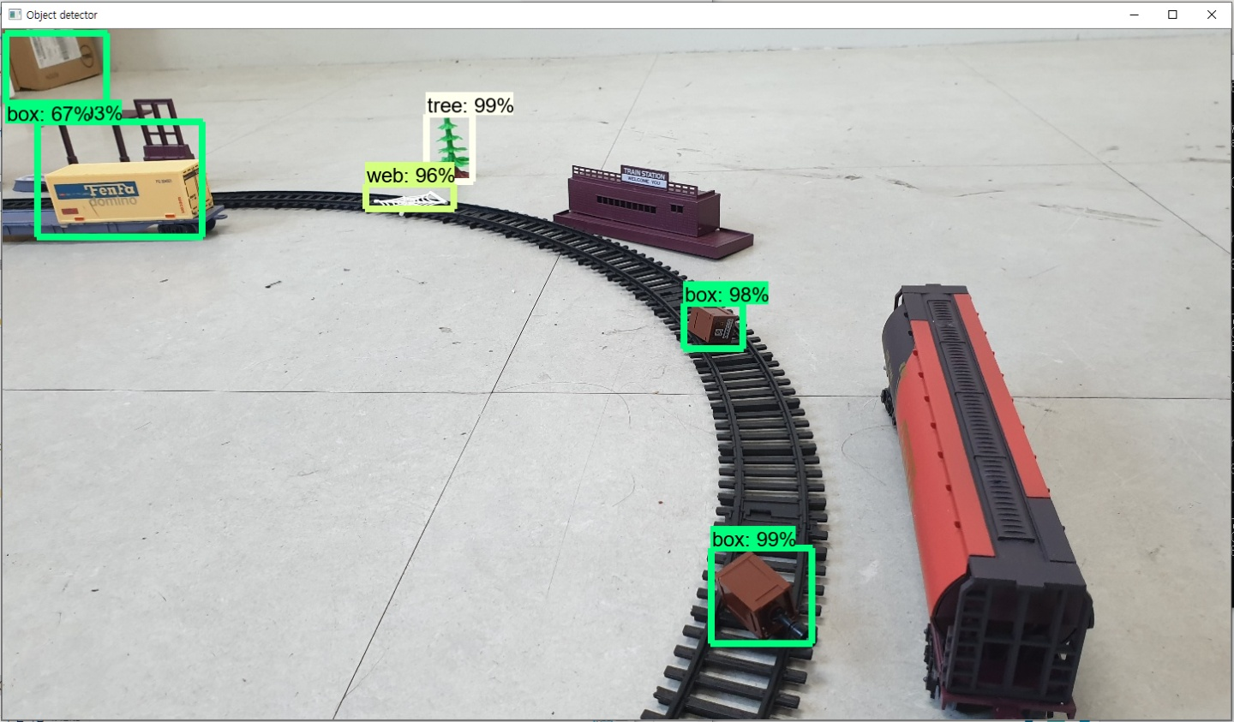
In Simulation

Slide 19

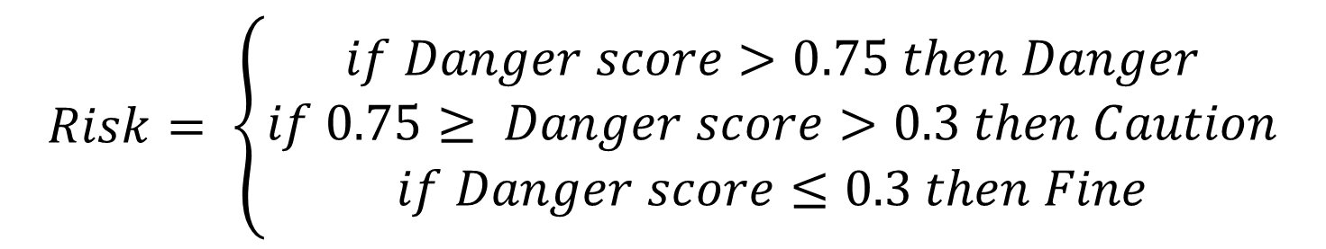
Mixing two models
Risk Quantification
$$Risk= \left\{\begin{aligned}if Danger score>0.75 then Danger \\ if 0.75≥ Danger score>0.3 then Caution \\ if Danger score≤0.3 then Fine\end{aligned}\right.$$
$$Danger score=\frac{\sum_{k=xmin}^{xmax}{P_{k,ymax} }}{xmax −xmin}$$

Slide 20
Fine
Fine
Fine
Danger
Danger
Danger
In Theory

Slide 21

Test
3
In simulated environment

Slide 22

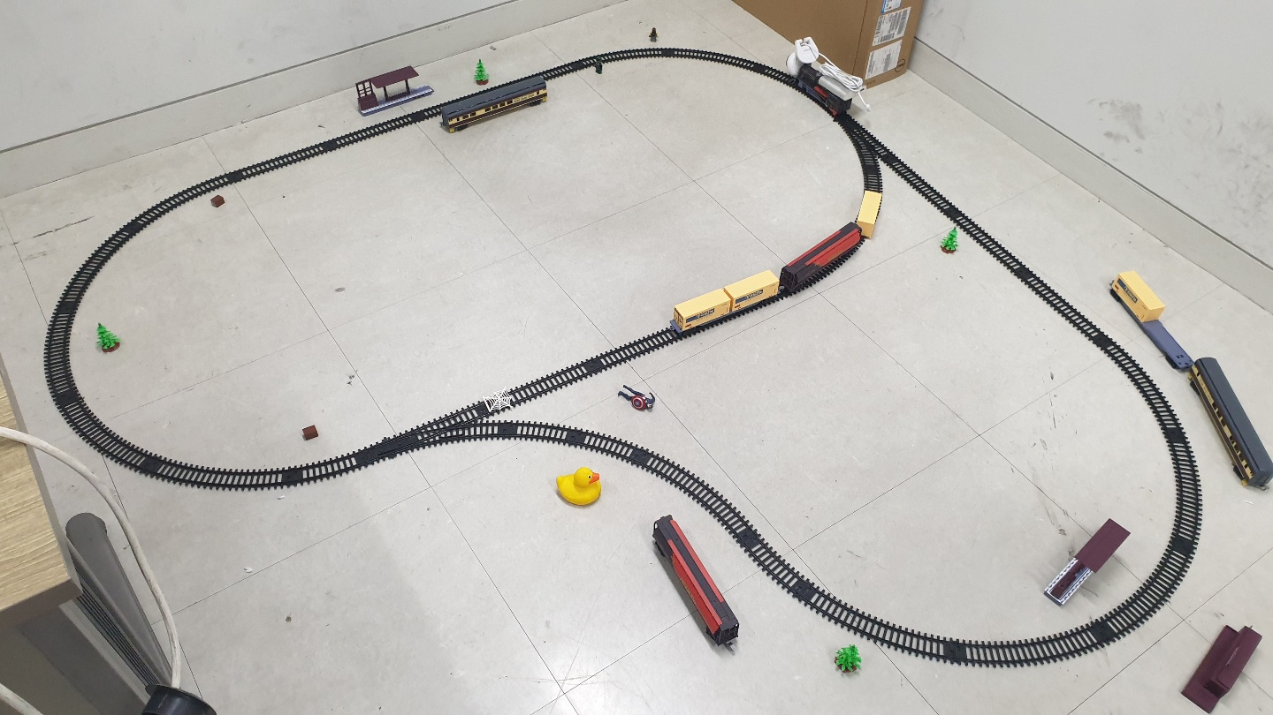
Simulation and test
Environment

Slide 23

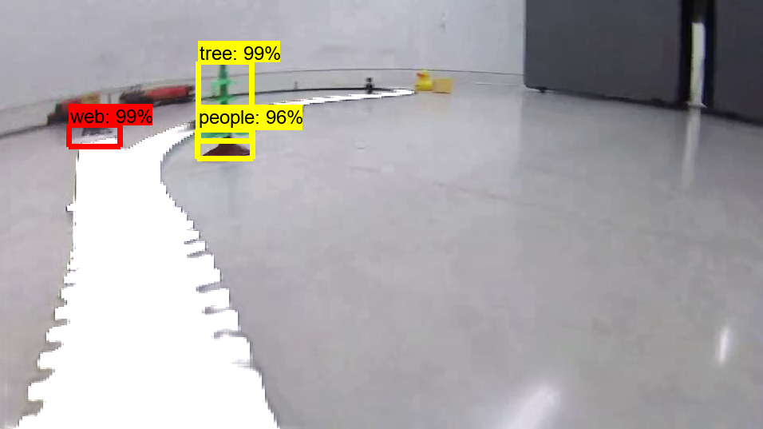
Simulation

Slide 24
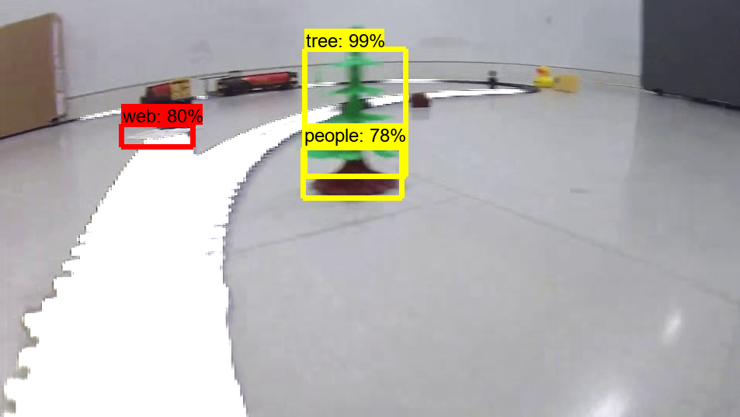
Simulation

Slide 25
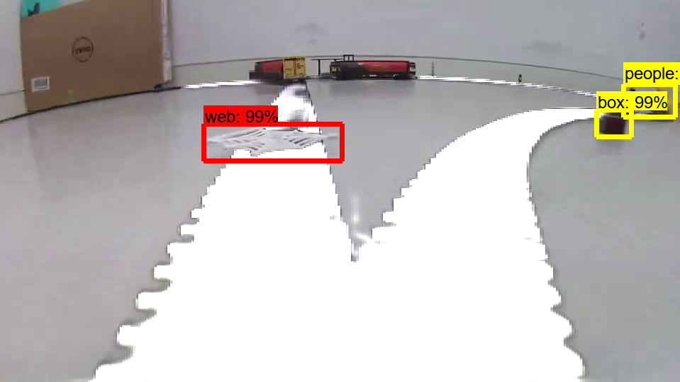
Simulation

Slide 26
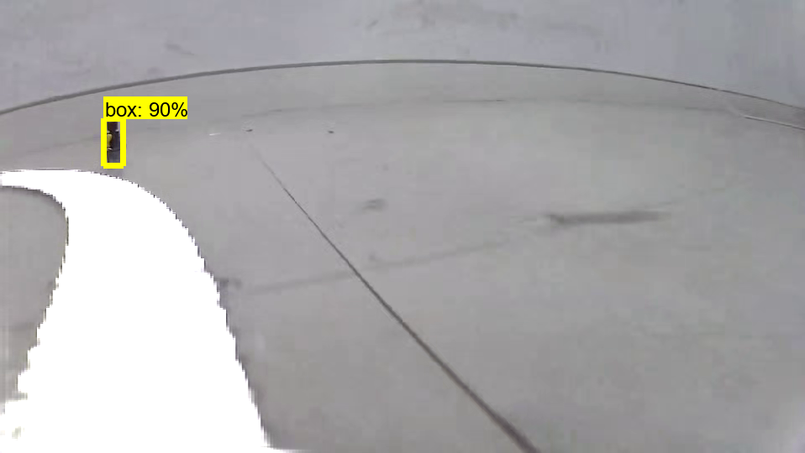
Simulation

Slide 27
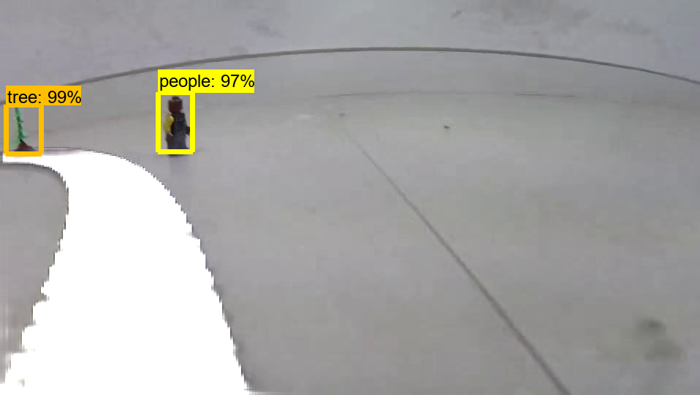
Simulation

Slide 28
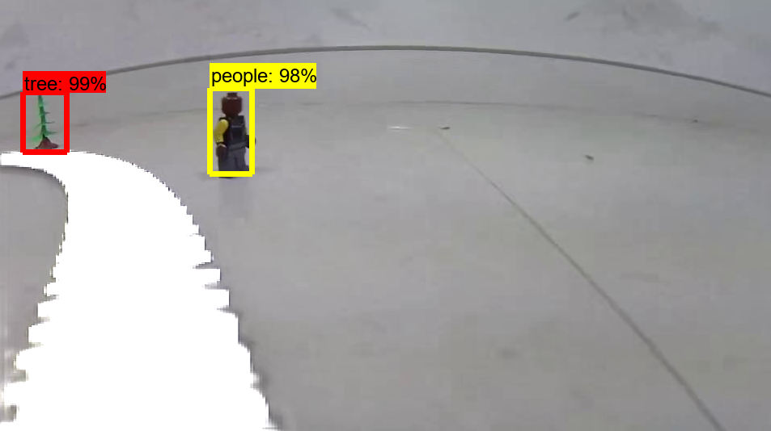
Simulation

Slide 29
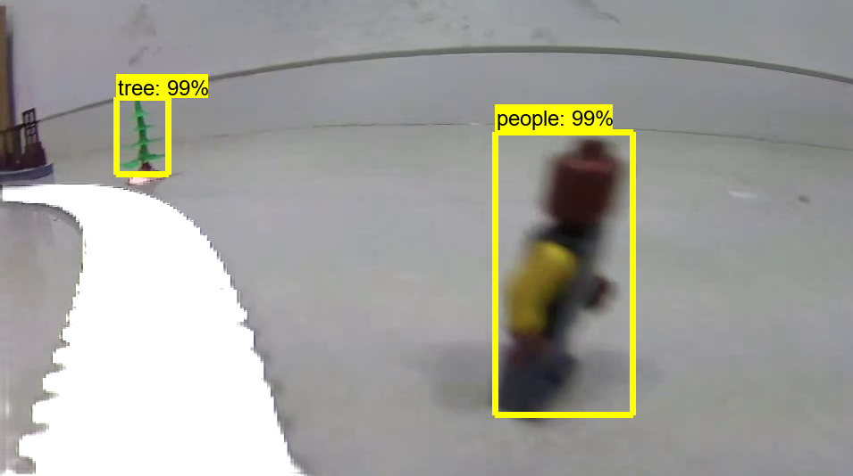
Simulation

Slide 30
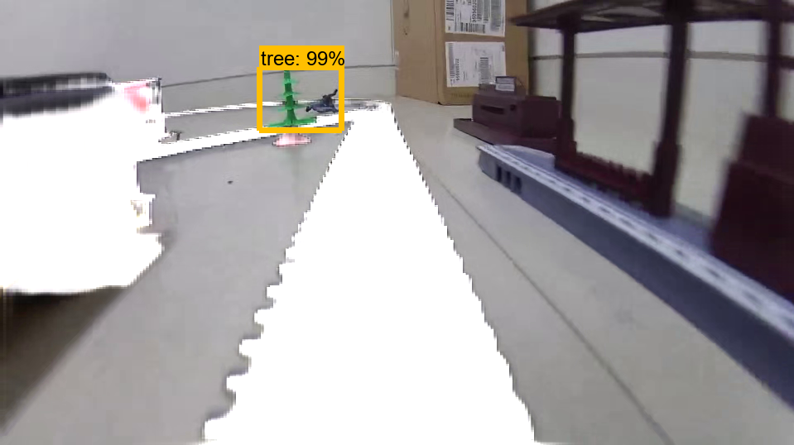
Simulation

Slide 31
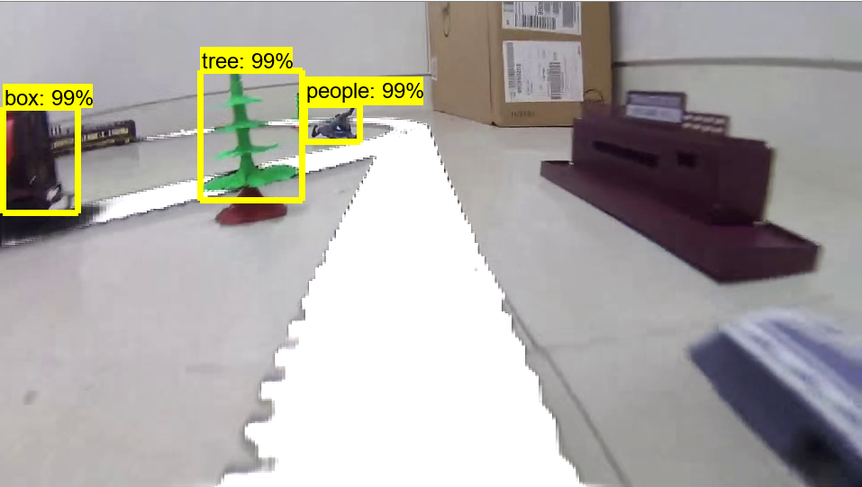
Simulation

Slide 32
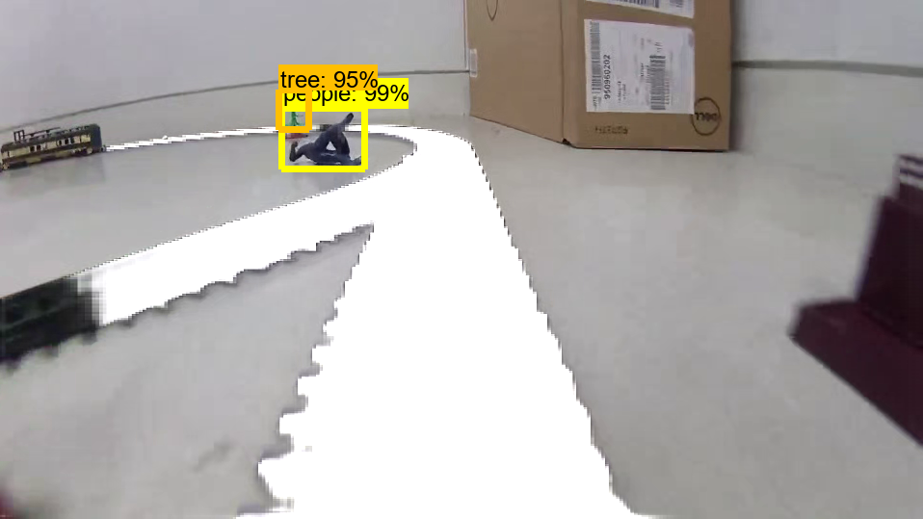
Simulation

Slide 33
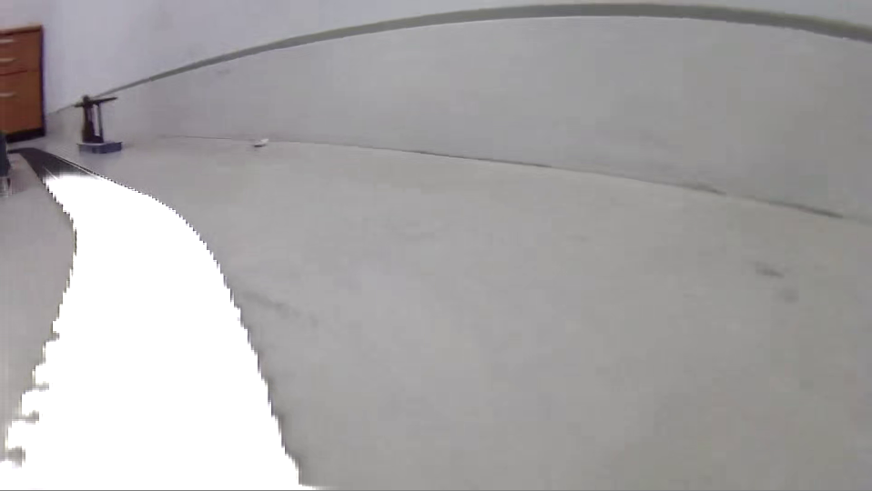
Simulation

Slide 34
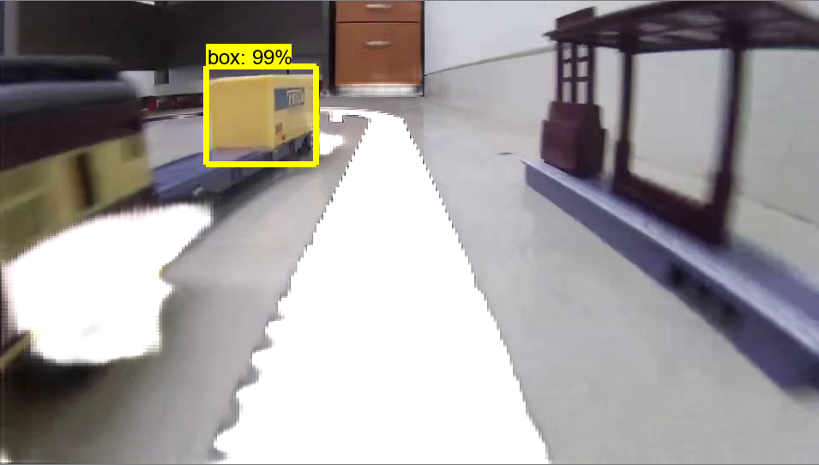
Simulation

Slide 35
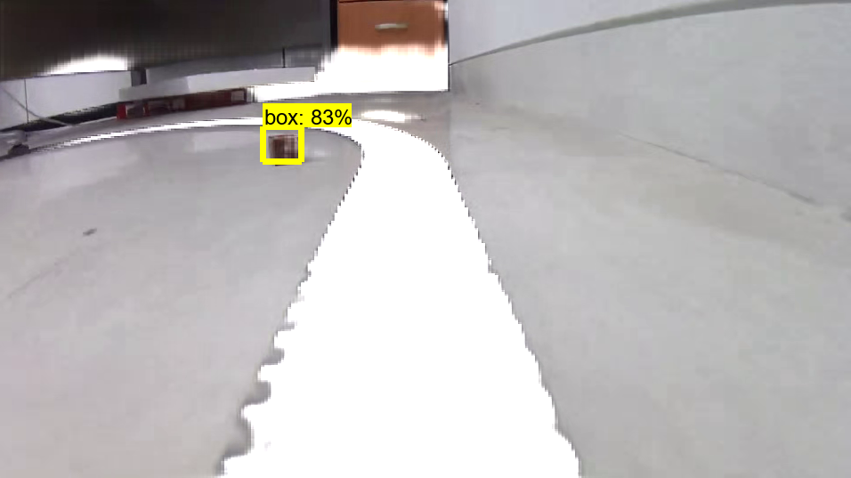
Simulation

Slide 36
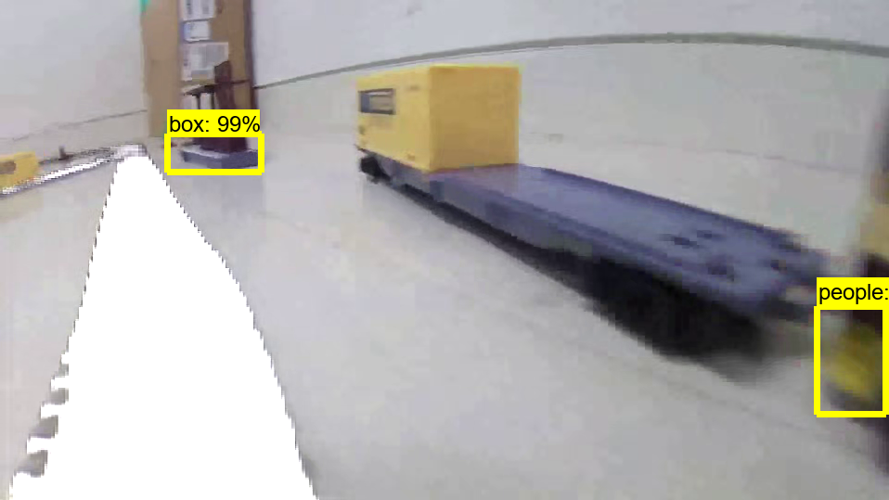
Simulation

Slide 37
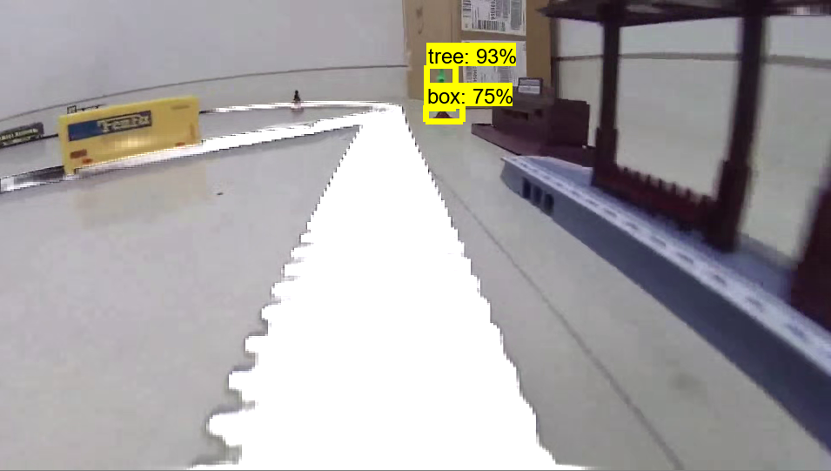
Simulation

Slide 38
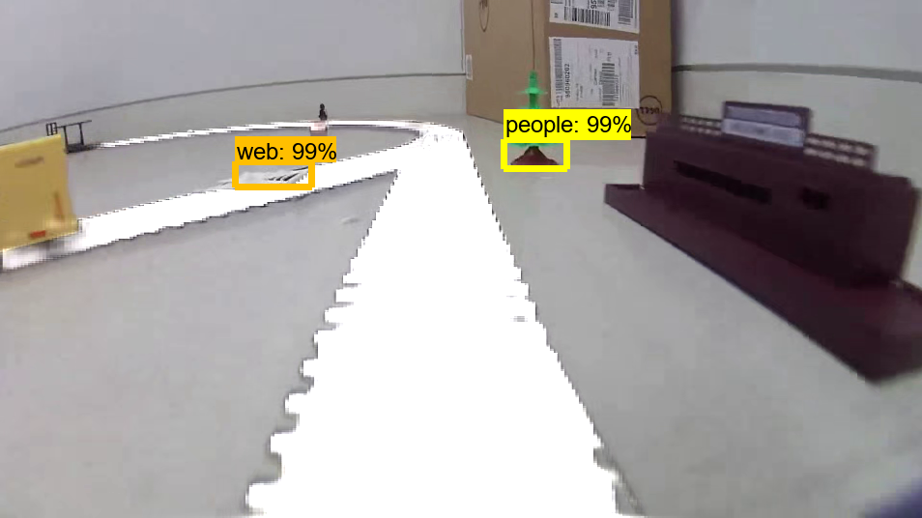
Simulation

Slide 39
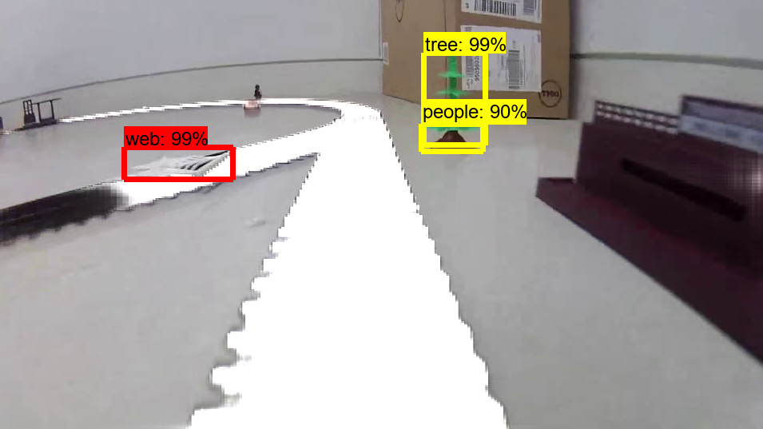
Simulation

Slide 40
Simulation

Slide 41
Simulation

Slide 42
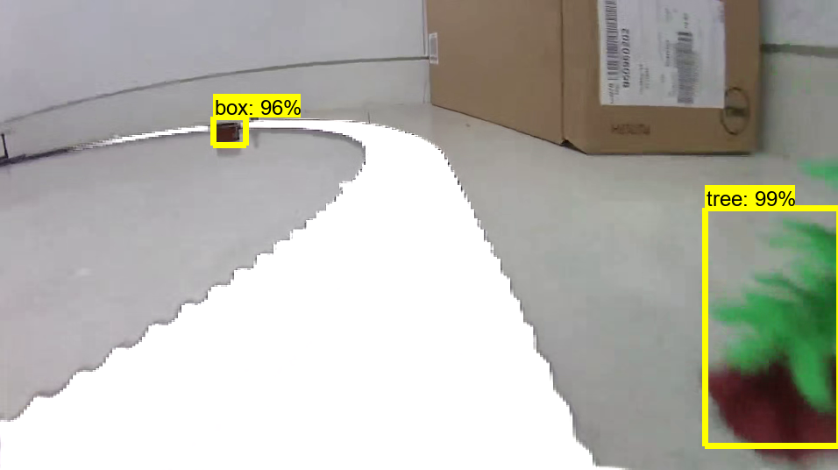
Simulation

Slide 43
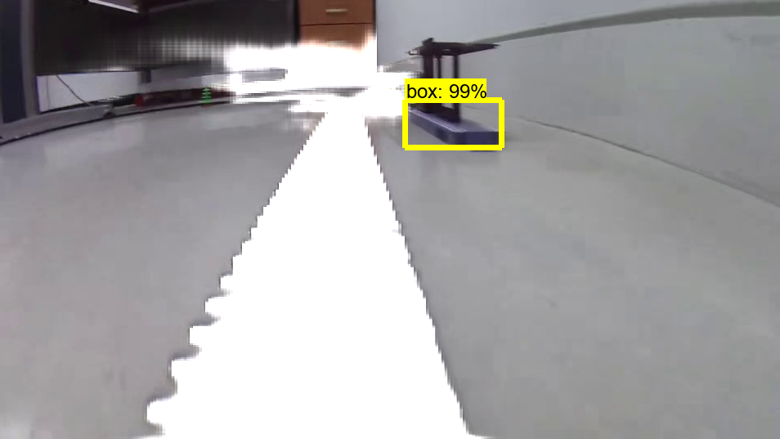
Simulation

Slide 44
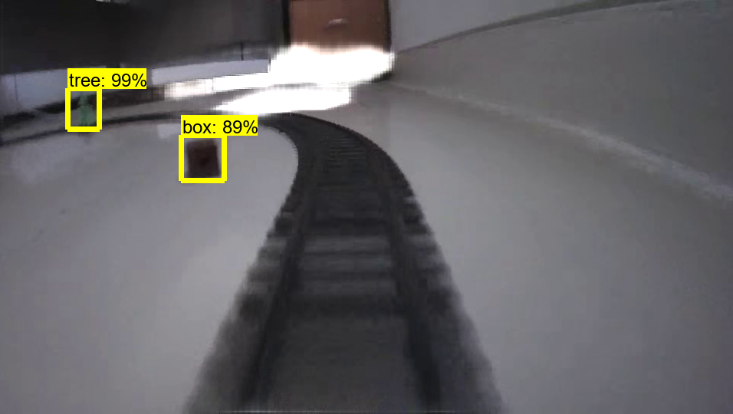
Simulation

Slide 45
Low recognition rate
More data is needed for training. Overall recognition rate is too low.
Some object is recognized to different object or tracks.
Specially, hardly recognize tracks at night.
Low speed
To apply in real train system, Speed must be fast.
First we expect speed about 30 frame per sec.
However, our result is about 5 frame per sec. Speed needs improvement.
Unexpected object recognition
To improve recognition rate, we decide to choose only 4 object to detect.
But in simulation, there are lots of objects we don’t train are detected.
This can reduce the reliability of our project.
What to improve that I think

Slide 46
Make counterplan for weather, light condition
If someone ask you about weather or light environment condition, you should be able to explain about this problem. Make counterplan for question.
Ask for hardware support
We have 2 computers for deep learning. You better use this, not your notebook. Make enough data first, request and run training on computer for deep learning.
Consider object in the real world, and add detail
Add more detail about object. For example, there is difference of risk between a standing person and a lying person. Bring results by reflecting these specific situations on the object.
The improvements that the professor said

Slide 47

Thank you for listening QnA

